Slide 1
Blending the Common Core State Standards and
Career Technical Education to Engage Title I Students
Educating for Careers

Slide 2

Objectives
TOM TORLAKSON
State Superintendent
of Public Instruction
What makes significant learning
Basic background information
  CCSS/CCRS/CTE
  Linked Learning/CPA
  Integrated Academics
  Collaboration with CORE/CTE
  6As of projects
Project Based Learning Analysis
Gallery Walks/Next Steps
Questions

Slide 3

Significant Learning
Write a detailed description of one of your most significant and powerful learning experiences when you were young, either in school or outside of school.
Include:
Setting
Characters
Conflict or plot
What made the experience memorable
Notes:
3

Slide 4
Share-Analyze
Find a partner
Listen for attributes of each others experience:
Who was there?
Where did the experience take place?
What made these experiences significant?
After sharing:
Make a list of elements of significant learning—be ready to share these out with the whole group
Notes:
4

Slide 5
Re-imagining Schools
Think of the stories you heard describing instances of significant learning….
What would a school look like in which experiences like these happened regularly?
After you write… Share your ideas with a neighbor and be ready to share with the whole group.
Notes:
5

Slide 6
TOM TORLAKSON
State Superintendent
of Public Instruction
CCSS
CTE
Integrated Academics
Career and College Readiness Standards Linked Learning
California Partnership Academies
Notes:
When we talk about integrated academics, we are refering to the integration of the common core state standards and the career technical education standards. This is demonstrated in many ways including the career ready practices, linked learning, California partnership academies and most notably in project and problem based learning.

Slide 7
Common Core State Standards
TOM TORLAKSON
State Superintendent
of Public Instruction
Designed to prepare students for both college entry and the workplace.
Rigorous, research-based college career readiness with grade level content
Notes:
The SBE adopted the CCSS in August 2010. Districts across the state are in various phases of implementation.

Slide 8
Common Core State Standards
TOM TORLAKSON
State Superintendent
of Public Instruction
  English-Language Arts: Grades 6–12
    English-Language Arts
    Literacy in History/Social Studies, Science and Technical Subjects (reading and writing for literacy)
  Mathematics: Aim to balance understanding and procedural skills
    Practice (recurring throughout the grades)
    Content (different at each grade level)
Notes:
This is just a review of the CCSS in ELA and Math. New to the ELA standards is the reading and writing in technical subjects. In the math the intention is to have a balance in the understanding of concepts and practice in procedural skills.

Slide 9
Career Technical Education Model Curriculum Standards
The CTE Standards are a tool to:
Foster the Career Readiness of all students.
Support mastery of essential employability skills and rigorous academic content standards.
Develop a highly skilled and educated workforce which contributes to economic prosperity.
Support a seamless transition to postsecondary education and/or career entry.
Improve student achievement.
TOM TORLAKSON
State Superintendent
of Public Instruction
Notes:
Included in the CCSS is the goal to have students career and college ready. The draft revision of the CTE model curriculum standards includes a focus for all students on career readiness (similar to the old SCANS skills), includes support for essential employability skills and alignment to rigorous academic standards. The revision of the CTE standards included extensive involvement from business and industry with the goal of developing a highly skilled and educated workforce. With the focus on career and college readiness the goal is also seamless transition to postsecondary education or career entry. And of course we want to help ensure improved student achievement.

Slide 10
CTE Standards
Common Core Considerations for CTE:
  More than individual presentations, emphasize teams, groups, pairs
  Utilize technology to demonstrate learning/mastery
  Use application, integration, critical thinking, problem solving
  Use research-based approach
  Use similar verbs whenever possible
  Career and postsecondary readiness is the goal for all educators
TOM TORLAKSON
State Superintendent
of Public Instruction
Notes:
In the revision of the CTE standards the workgroups took in to consideration the common core. You will see that the CTE standards include performance indicators that encourage lessons which include more individual presentations and group work as well the utilization of technology to apply and integrate curriculum.

Slide 11
California’s 15 Industry Sectors:
Agriculture and Natural Resources
Arts, Media, and Entertainment
Building and Construction Trades
Business and Finance
Education, Child Development, and Family Services
Energy, Environment and Utilities
Engineering and Architecture
Fashion and Interior Design
Health Science and Medical Technology
Hospitality, Tourism, and Recreation
Information and Communications Technology
Manufacturing and Product Development
Marketing, Sales, and Service
Public Services
Transportation
TOM TORLAKSON
State Superintendent
of Public Instruction
Notes:
The CTE standards are written for 15 industry sectors.

Slide 12
Career Technical Education Standards Continuum
Pathway Standards
Industry Sector Anchors
(Knowledge and Performance Anchor Standards)
Standards for Career Ready Practice
Industry Specific
Employer
TOM TORLAKSON
State Superintendent
of Public Instruction
Notes:
The CTE standards are designed along a continuum. At the base are the Career Ready Practices which are for all high schools students. The next level are the industry sector anchor standards which are standards that encompass aspects of all the pathways within an industry sector. Next are the specific pathway standards. The next level of the continuum are often found in adult schools, ROP programs, community college or the university level. These are the specific standards that a student would need to complete a certificate in a particular field for employment.

Slide 13
INTEGRATED ACADEMICS
Career and College Readiness
Full range of postsecondary options
Engaging and motivating all students
Collaboration with postsecondary and articulation
Linked Learning
Four Key Components to Implement:
  An integrated core academic curriculum
  An integrated career technical core curriculum
  A series of work-based learning opportunities for students
  Student support services
Project- and Problem-Based Learning
Interdisciplinary projects
Work-based learning
TOM TORLAKSON
State Superintendent
of Public Instruction
Notes:
When we look at combining aspects of the CTE model curriculum standards and the CCSS we are talking about integrated academics. Both sets of standards include the goal of preparing students to be Career and College Ready.
This includes:
Preparing high school students for careers and a full range of postsecondary options
Improving postsecondary readiness by engaging and motivating all students to maximize their educational and career potential
Collaboration between secondary and postsecondary institutions as well as articulations between middle grades and high schools
A common term in the integrated academics arena is Linked Learning
Linked Learning has Four Key Components:
An integrated core academic curriculum
An integrated career technical core curriculum
A series of work-based learning opportunities for students
Student support services
Another term associated most often with integrated academics is the idea of Project- and Problem-Based Learning where teachers utilize interdisciplinary projects and work-based learning to enhance integration.
Example: Students in a building and engineering pathway might learn about geometry and algebra while actually designing and building a structure using industry-standard architectural methods and practices.
Example: Students in an arts, media, and entertainment pathway might learn and use persuasive writing skills while developing an industry business model or use creative writing skills while drafting a script.

Slide 14
Career Partnership Academies
Linked Learning approach combines academics and career focus
Academic and career technical coursework:
Rigorous
Project-based
Relevant
Engaging
Connecting all stakeholders
TOM TORLAKSON
State Superintendent
of Public Instruction
Notes:
An example of a Linked Learning approach combining academics with a career focus is the integration of academic and career technical coursework that is:
rigorous
project-based
Relevant
Engaging
It ultimately connects students, faculty, and business leaders in new productive relationships

Slide 15
Other Forms of
Linked Learning
The Center for Advanced Research and Technology (CART) in Fresno and Clovis:
Eleventh and twelfth grade students
Half-day classes
Instructors from both education and business
Project-based labs
Academic, technical, entrepreneurial, critical thinking skills
Sciences, engineering, advanced comm, and global dynamics
Industry-based projects, career learning labs, integrated academics
Collaborative design of student programs of study
TOM TORLAKSON
State Superintendent
of Public Instruction
Notes:
The Center for Advanced Research and Technology (CART) in Fresno and Clovis:
Eleventh and twelfth grade students attend half-day classes taught by teams of instructors from both education and business, integrating subjects into project-based labs.
Linked Learning approach combining rigorous academics with technical, design, process, entrepreneurial, and critical thinking skills around career clusters.
Career clusters include professional sciences, engineering, advanced communications and global dynamics.
Within each cluster are several career-specific laboratories where students complete industry-based projects and receive academic credit for advanced English, science, social science and technology.
Students work with teachers, parents, and businesses to design a program of study to pursue the postsecondary path of their choice from entry-level positions to industry certifications and university admission.

Slide 16
CPA Facts
50% enter program as "at-risk students“
Graduation rate:
  95% for CPAs vs. 85% statewide
African-American grad rate:
  92 % for CPAs vs. 76% statewide
Hispanic grad rate:
  94% for CPAs vs. 80% statewide
A-G student completion:
  57% for CPAs vs. 36% statewide
  88% CPA college-going rate
Similar evidence from 2006 CPA report
TOM TORLAKSON
State Superintendent
of Public Instruction
Notes:
Another form of integrated academics are the California Partnership Academies.
Demographic data from the CPAs indicates that 50 percent of CPA students enter the program as "at-risk students"
A Profile of the California Partnership Academies 2009-2010:
CPA graduation rate: 95%
Statewide graduation rate: 85%
57% of CPA graduates fulfilled A-G course requirements
36% of graduates statewide
A 2006 report on CPAs showed similar results, so longitudinal evidence
88% of CPA students plan to attend a two- or four- year college upon graduation
African-American graduation rate: 92 % for CPAs, 76% statewide
Hispanic graduation rate: 94% for CPAs 80% statewide
16

Slide 17
CART’s data from 2002-2008
71% of CART students in community college
60% of non-CART in community college
Same percentages one year after high school
Postsecondary up 2% for CART vs non-CART
TOM TORLAKSON
State Superintendent
of Public Instruction
Notes:
CART’s data show that from 2002-2008:
71% of CART students attended a community college
60% of a demographically similar group of non-CART students attended community college
The same percentage difference holds true one year after high school.
University enrollment was also two percentage points higher for CART students as compared to similarly matched non-CART students.

Slide 18
Project- and Problem-Based Learning
TOM TORLAKSON
State Superintendent
of Public Instruction
Applied learning often takes the form of project- or problem-based learning.
Promotes problem-solving skills and higher-order thinking.
Link school-based instruction with activity beyond the class
Value of approach beyond success in school
6As of a project based learning
Notes:
Applied learning often takes the form of project- or problem-based learning.
Applied learning promotes problem-solving skills and other forms of higher-order thinking.
Applied learning links school-based instruction with activity that has consequences beyond the class or value beyond success in school.
Thus the results include increased gradation rates and college or career entrance rates.

Slide 19
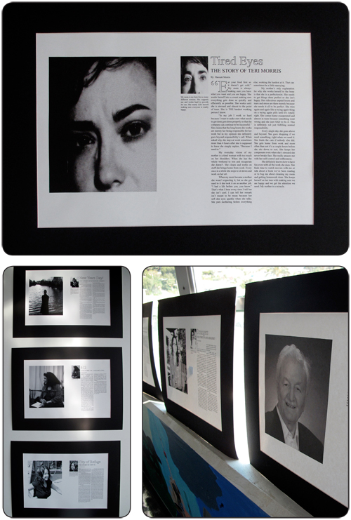
Authenticity
Projects:
use a real world context (e.g., community, workplace problems)
address issues that matter to the students.
Record evidence of academic rigor in the project you selected. If you do not see it, you may hypothesize what academic rigor may be present in a project like this.
Notes:
19
By combining the concepts needed to pass the state test with dramatic and exciting visuals, the students explained the science in their own words. Here we see how conservation laws can be used to predict the speed and trajectories of objects involved in a collision.

Slide 20
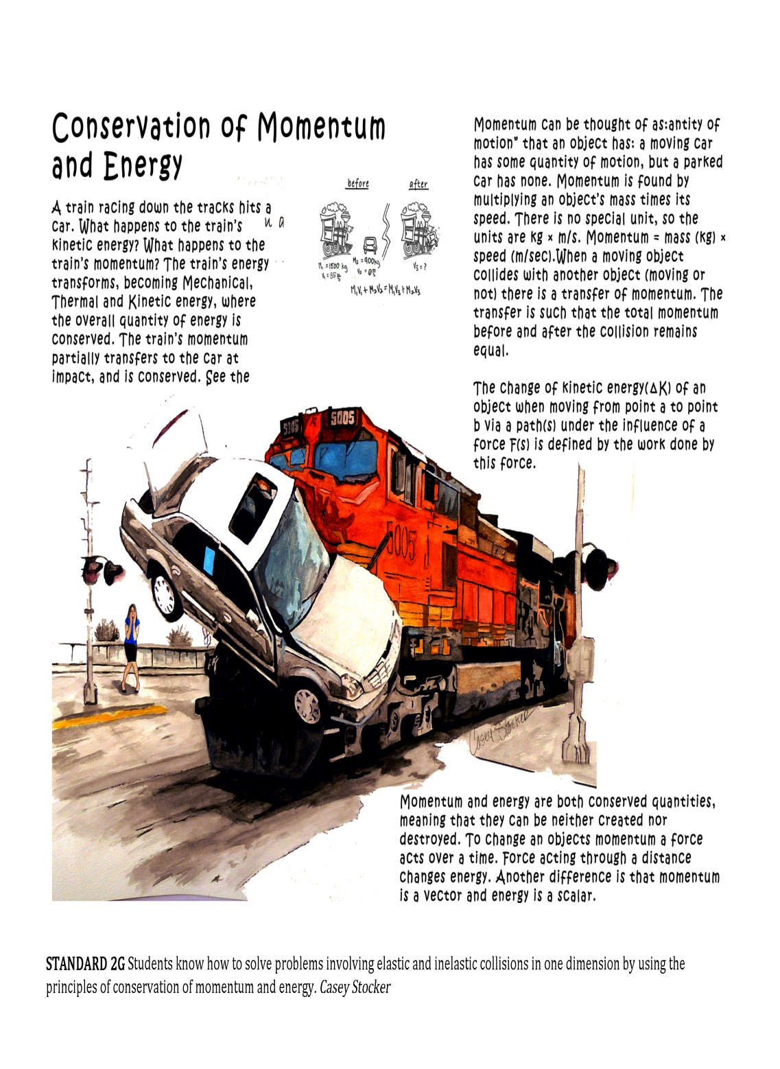
Academic Rigor
Projects:
Address key learning standards identified by the school or district
Pose essential question(s) of relevance to student
Span multiple disciplines and subject areas
Develop habits of mind and work associated with academic and professional disciplines (e.g., to think like a scientist)
Notes:
20
By combining the concepts needed to pass the state test with dramatic and exciting visuals, the students explained the science in their own words. Here we see how conservation laws can be used to predict the speed and trajectories of objects involved in a collision.

Slide 21
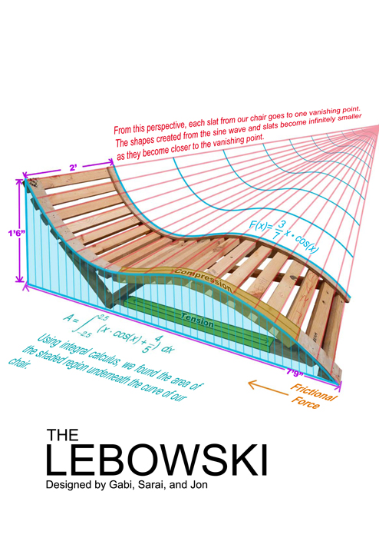
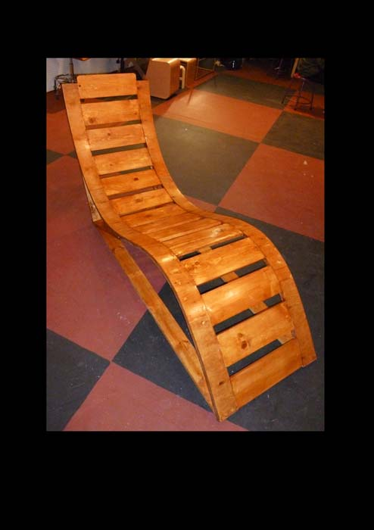
Applied Learning
Projects:
Engage students in solving semi-structured problems
Call for competencies expected in high-performance work organizations (e.g., teamwork, problem-solving, communication, etc.).
Require students to develop organizational and self-management skills
Notes:
21

Slide 22
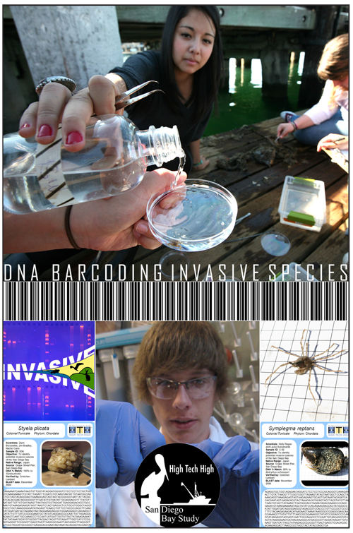
Active Exploration
Projects:
Extend beyond the classroom
Connect to field-based investigations, community explorations, and work internships
Require real investigations using a variety of methods, media, and sources
Notes:
22

Slide 23

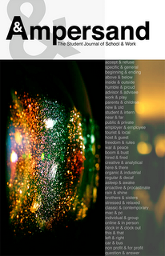
Adult Connections
Projects:
Connect students with adult mentors and coaches from the wider community
Expose students to adults with relevant expertise
Engage adults in the design and assessment of student projects
Notes:
23

Slide 24
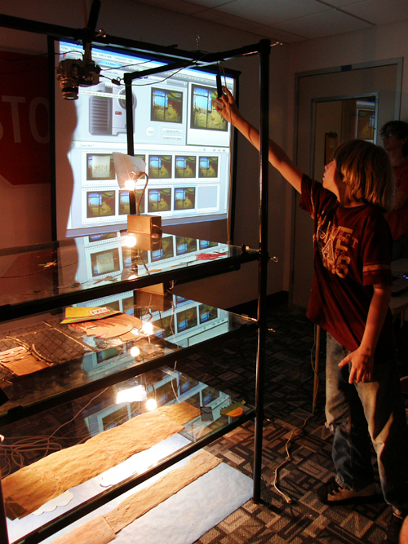
Assessment Practices
Projects:
Provide milestones/checkpoints
Involve lots of reflection for students and teachers
Result in exhibitions and performances
Are grounded in personal, school and real-world standards of performance
Notes:
24

Slide 25
Project Analysis
1. Find a partner
2. Select 2-3 project cards
3. Examine each card and share:
Why you chose it?
How it might connect to the CTE Standards ?
How it might connect to your practice?
4. Be Ready to share your findings with the group.

Slide 26
Group Brainstorming-Next Steps
What have you learned?
What questions do you have?
What ideas can you steal for your own work?
How can we incorporate elements of CTE in our work?
Notes:
50 percent of CPA students enter the program as "at-risk students"
A Profile of the California Partnership Academies 2009-2010:
CPA graduation rate: 95%
Statewide graduation rate: 85%
57% of CPA graduates fulfilled A-G course requirements
36% of graduates statewide
A 2006 report on CPAs showed similar results, so longitudinal evidence
88% of CPA students plan to attend a two- or four- year college upon graduation
African-American graduation rate: 92 % for CPAs, 76% statewide
Hispanic graduation rate: 94% for CPAs 80% statewide
26

Slide 27
Questions?
TOM TORLAKSON
State Superintendent
of Public Instruction
Carolyn Zachry, Ed.D., Education Programs Consultant
Career Technical Education Administration and Management Office
California Department of Education
916-323-5042
czachry@cde.ca.gov
Nicole Hinostro
High Tech High
nhinostro@hightechhigh.org
www.hightechhigh.org

